Slide 1
CES Assessment Update
Los Angeles Homeless Services Authority
Marina Genchev, MSW
Director, Systems & Planning
January 23, 2024

Slide 2
CESTTRR Tool Implementation Timeline
Summer 2024 - Ongoing
Winter 2024
Spring 2024
Summer 2024
Hire Consultant
Develop Training
Conduct Trainings
Tool Implementation
LAHSA will hire a consultant to develop a training curriculum for the new tool that includes a race equity component. LAHSA wants to ensure that an expert in the field is supporting creating and implementing training for the system.
Given the history of racial bias in previous tools and their administration, LAHSA and consultant will develop tool trainingthat includes trauma informed care and awareness of implicit bias.
LAHSA will offer trainings for many months before implementing the new tool for the adult system, to allow adequate time to equip system staff.
LAHSA will begin using new tool as part of updated PSH Prioritization Guidance that includes other prioritization factors. Case conferencing remains valid method.

Slide 3
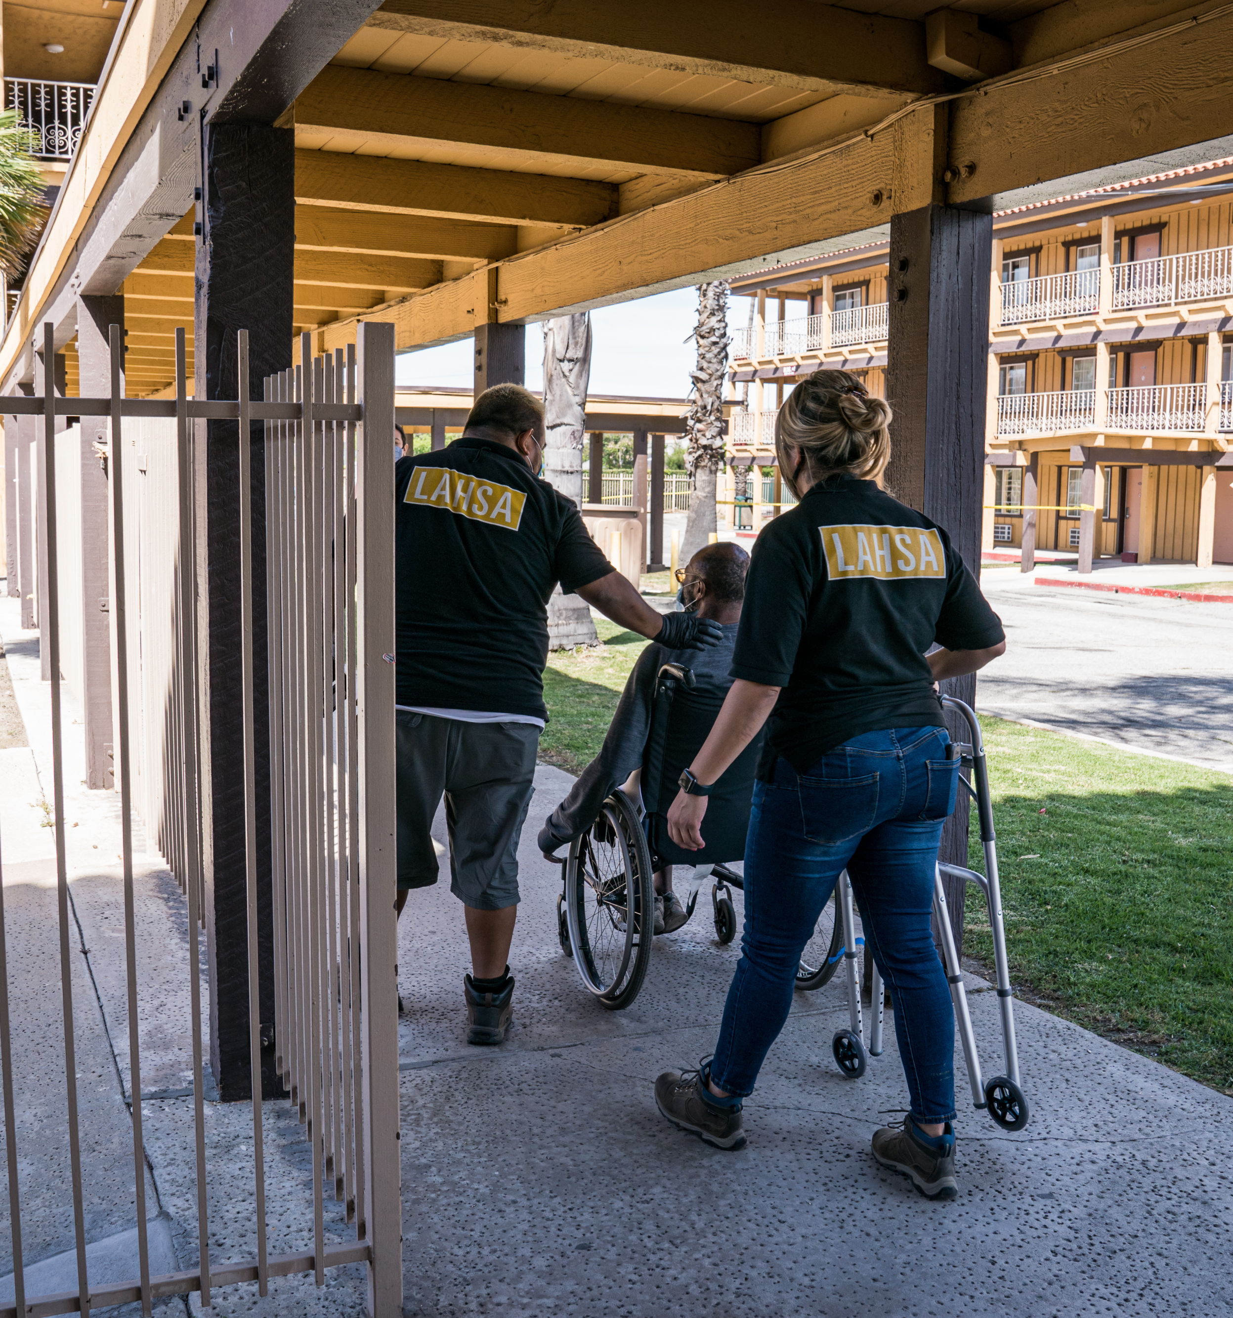
Use of New and Existing Assessment Tools in Los Angeles
As of July 2022, VI-SPDAT no longer needed for intake/prioritization for:
Outreach, Interim Housing, Housing Navigation, and Rapid Re-Housing
VI-SPDAT still used for PSH:
Score of 8+ can be prioritized; score no longer used in descending order
Prioritization based on document readiness and program enrollment
Programs that should still conduct the VI-SPDAT:
CES Access Points and agencies providing Access to CES
Outreach, Access Centers, Interim Housing, Housing Navigation, and Victim Service Providers, etc.
Timing of VI-SPDAT
Conduct only upon establishment of rapport
Must be done if not connected to housing/pathway after 90 days
Not needed if already connected to housing/pathway
→ New CESTTRR tool will be implemented under similar guidance
Implementing Housing Acuity Index
For those housed in Rapid Re-Housing
To identify those in need to transfers to PSH

Slide 4
CES Reimagined
CES Presentation
Active System Management to Promote System Flow & Utilization
New PSH Prioritization & “Batch Matching”
Creating Equity Allocation Policies
Centering the Voice of Lived Experience
Tracking System Key Performance Indicators
Creating Equity Evaluation Framework & Goals
Targeted Use of New & Existing CES Assessment Tools
Notes:
We created bottlenecks and slowdowns in the first iterations and are actively managing key parts of the system to ensure that they contribute to quick, effective and equitable referrals, assessments, and move-ins so that we are optimizing the number of people we are getting off the street and into housing.
Active System Management – a hands-on management process to ensure each component of the homeless system response is performing as effectively as possible to support maximum throughput to permanent housing​
New PSH prioritization – using CES score and program enrollment differently to ensure quicker referrals and quicker lease ups​
Batch matching – to send more referrals for project-based lease ups​
Universal Housing Application (UHA) – an online universal application that can be utilized across multiple properties​
Universal Forms – working with the PHAs to create streamlined forms​
New CES Assessment Tools - the CES Triage Tool Research and Refinement (CESTTRR) project was a community driven process that used data science to create a shorter, more trauma informed, less racially biased assessment tool that will be used a factor in the PSH prioritization process in the future​
Ongoing evaluation – LAHSA will evaluate changes to the system and PSH on an ongoing basis

