Slide 1
Redesigning Coordinated Entry through the Lens of Race Equity
in San Francisco
Cynthia Nagendra
Deputy Director
San Francisco Dept of Homelessness and Supportive Housing
January 2024

Slide 2
Purpose of Redesigning CE Coordinatedd Entry
To redesign and refine the San Francisco Homelessness Coordinated Entry (CE) System so that CE processes and outcomes are more equitable and increase access to housing and services for people who have been historically marginalized and most impacted by homelessness and structural racism
Meeting Materials Found Here:
https://hsh.sfgov.org/services/the-homelessness-response-system/coordinated-entry/coordinated-entry-redesign/

Slide 3
Purpose of Redesigning CE Coordinatedd Entry
Address racial inequities in homelessness caused by structural racism by targeting households who have been historically marginalized and systemically excluded from access to housing. Reduce unsheltered homelessness by targeting resources and redesigning processes for people who are currently experiencing unsheltered homelessness. Decrease inflow into homelessness by targeting prevention and problem-solving resources for people at an imminent risk of experiencing homelessness.

Slide 4
Background
CE Evaluation
PHASE 1: July 2022
Coordinated Entry Evaluation
The CE system “has been operationalized in ways not well understood by system users and with significant criticism and reservations from the provider community”
Need for more transparency, clearer policies and communication
Challenges in data collection & utilization
Lack of community involvement
Equity impacts across all components of CE
People do not know where to receive help and/or are frustrated by lack of help at Access Points
Concern that problem solving is not an “appropriate intervention,” that assessment questions are too sensitive and are not being used to provide meaningful support, and that housing referrals are inappropriate
Criticism of inventory-based prioritization scheme
“I didn’t get help. I keep getting the run around. I’ve done 8 different CES”
“They told me I wasn’t homeless enough to get their help.”
“I was offered units that did not match my ADA needs.”
“A lot of run around and miss information [sic] given. Homeless people have trouble keeping up with important documents or being notified of appointments, and if an appt is missed that you weren't aware of, you have to start the whole process over again.”

Slide 5
Background
CE Recommendations
PHASE 2: October 2022 - April 2023
Redesigning Coordinated Entry
Goals of Phase 2:
Develop community-driven recommendations to improve the CE system that are responsive to the CE evaluation and people’s experiences with CE
Collaborate authentically and transparently with the community and share decision-making power
New workgroup prioritized the inclusion of people who represent groups most disparately impacted by homelessness in SF
HSH compensated People with Lived Expertise (hourly rate: $100 per hour)
Significant amount of time spent on establishing relationships & on culture change work to rebuild trust
CE Redesign Recommendations
New CE governance & oversight that embeds PWLE
Improve how people access Coordinated Entry (access)
Improve how we understand, identify, and match people to resources (assessment, prioritization, referral)
Home by the Bay Values in CE Redesign
Leadership and Guidance from People with Lived Expertise
Collaborative Relationships and Shared Decision Making
People Centered and Strengths-Based
Accountable
Compassion
Respectful and Inclusive
Courage
Equity and Justice
Quality

Slide 6
Cultural Transformation:
The Way We Treat Each Other is as Important as The Work Itself
“I really didn’t believe that this process would do what it intended to do... I work directly with families everyday who experience homelessness, and I also have my own lived experience of homelessness...
When this process started, I was pretty jaded and burnt out, but now after participating in this group, I feel like, not only do I see that this is a transformation of CE, but it’s also been a transformation for me. I feel really heard and hopeful. I see that our community is aligned with HSH on many of the CE-related issues and that positive change is definitely possible and that it’s coming... It’s just really big, and it’s been amazing for me to be able to participate in this process.”
-CE Redesign Workgroup Member

Slide 7
Current Work
Implementation
PHASE 3: May 2023 - Present
Implementation
Goals:
Implement and operationalize the CE redesign recommendations
Conduct continuous quality improvement of the CE system post-implementation
Work to Date
Level-setting and knowledge sharing
Culture change and relationship-building
Identified shared priorities to start with
Developed and received approval of the group’s charter
Created subcommittees and workplans
Governance and Oversight
How People Connect to CE (Access)
How We Understand People and How We Identify and Match People to Resources (Assessment, Prioritization, and Referral)
New CE Redesign Implementation Committee (CEIC) to serve as key partner with HSH and the LHCB on oversight of the CE system
24 community members, including LHCB CE chair
4 HSH (CE) staff
1 HSA staff & 1 DPH staff
69% have lived expertise of homelessness
Majority identify as BIPOC, 20% identify as TGNCI, and 37% identify as LGBQ+
PWLE are being compensated

Slide 8
Subcommittee Update
Governance & Oversight
Key Milestones:
Developed group charter in October 2023; approved by the LHCB on December 4, 2023
Charter reflects culture change and a new way of working with the community
HSH facilitated the conversations, but all decisions were made by the community
Community took ownership of the charter and presented it to LHCB CE and LHCB
Centered the input of people with lived experience
Charter Highlights: Shared Power and Decision Making
In line with the federal regulations, the CEIC will have decision-making authority over CE policy; HSH will continue to have authority over CE operations
CEIC will play key role in CE continuous quality improvement, including reviewing performance benchmarks and recommending improvements
CEIC will be an ongoing body
Members will serve for at least 2 years
CEIC will be led by the community, in collaboration with HSH and other City departments
CEIC will elect their own co-chairs
Group aims to operate by consensus
If voting is needed, HSH as a whole will receive one vote
Current Work
Developing a CE vision, mission, and values
Developing a draft Client Bill of Rights, with community input
Creating an accompanying document to the charter with more specific HSH vs. Committee responsibilities
(Future Work): Establishing a monitoring committee to hear grievances

Slide 9
Subcommittee Update
How People Connect to CE: Radical Hospitality
Current Work Underway:
Establish standardized training requirements, job shadowing, curriculum, technical assistance, and professional development opportunities for all CE staff providers
Set Access Point expectations for RFPs
Define “no wrong door”
Figure out how subpopulations will be served and whether there will be specific Access Points for specific subpopulations
Discuss possibility of geographic availability/more options for Access Points
Understand current Access Point landscape (e.g., services and training provided, staff supports, pay structures, etc.)
Longer-Term Work (in 1-2 Years)
Establish new training content areas
Establish a peer training program for people with lived experience to work at Access Points, train Access Point staff, and ensure staff are representative of people served
Increase staffing, support strategies, and salaries and set baseline expectations to prevent burnout and compassion fatigue
Future work includes creating more diverse Access Points with expanded access, establishing CE messaging, and creating a quality experience at Access Points

Slide 10
Subcommittee Update
How We Understand People/Match to Resources: Radical Inclusion
Current Work Underway:
Understand current assessment process
Develop new prioritization structure/criteria
Think through shelter queue for family CE
Develop more inclusive screening process for housing referrals
Discuss whether to eliminate housing threshold statuses
Longer-Term Work (in 1-2 Years)
Create, test, communicate, and implement new/revised assessment process
Develop a call-in system so clients can call-in and get updates on their housing status
Future work includes promoting client choice in housing referrals (e.g., allowing for neighborhood choice, reducing documentation, presenting all housing options but formally revisiting that along the way)

Slide 11
Reflections
What is Going Well
More community buy-in
Process “feels different”; more authentic collaboration
Ability to empower and resource PWLE
Created a CE infrastructure that aligns with federal regulations
Challenges
Culture change work is difficult
Some HSH pushback; trust in the process has not been fully established
Lack of role clarity among staff and challenges with communication
Need to balance having people be informed while also not overwhelming the group with HSH members
Community still does not feel fully empowered; HSH is still driving much of the conversation
Needing to balance sense of urgency with transformational change
The community is eager for things to change, but we also need to take time to build relationships and establish trust
Importance of building in time for transparency and for the community to feel they have ownership over decisions
Lessons Learned/Summary:
This process is an embodiment of HSH’s and HBTB’s values and guiding principles, but the work is not easy
Requires a new way of doing things, which can make some people feel uneasy
Importance of breaking down silos at the start, ensuring that managers/directors are communicating with their staff, and that roles are clear
If people have different perspectives, leadership may need to step in and make a decision, and those decisions need to be documented and clearly communicated
Notes:
PWLE are given decision-making authority, are making public presentations and feel like they can own the work

Slide 12
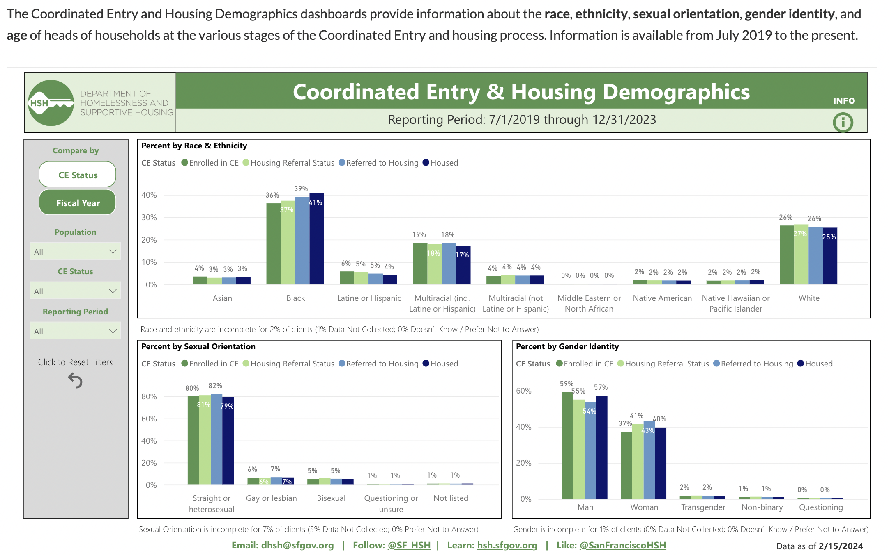
New Tools to Advance Racial Equity
Coordinated Entry Demographics Dashboard
to
Track Equity in
Each Component of the
CE Process
https://hsh.sfgov.org/about/research-and-reports/hrs-data/coordinated-entry-demographics/
Challenges
Culture change work is difficult
Some HSH pushback; trust in the process has not been fully established
Lack of role clarity among staff and challenges with communication
Need to balance having people be informed while also not overwhelming the group with HSH members
Community still does not feel fully empowered; HSH is still driving much of the conversation
Needing to balance sense of urgency with transformational change
The community is eager for things to change, but we also need to take time to build relationships and establish trust
Importance of building in time for transparency and for the community to feel they have ownership over decisions
Notes:
PWLE are given decision-making authority, are making public presentations and feel like they can own the work

