Slide 1

USC Homelessness Policy Research Institute (HPRI)
Welcome to our afternoon session…
Benjamin Henwood, PhD, LCSW
Flourishing Summit
September 11, 2025
METHODS |

Slide 2
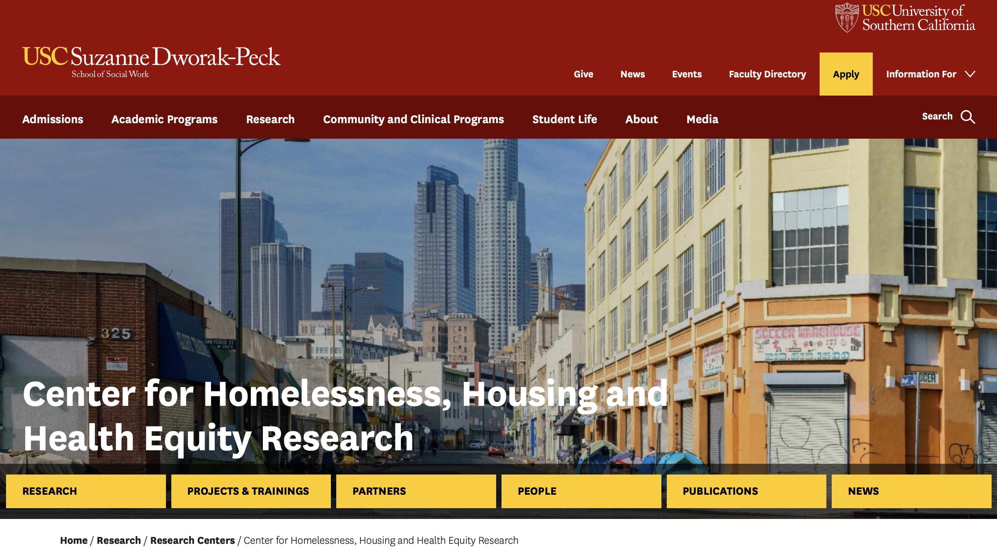
https://dworakpeck.usc.edu/research/centers/homelessness-housing-health-equity

Slide 3

*October 23, 2025

Slide 4

https://hpri.usc.edu
HPRI is a collaborative of over one hundred fifty researchers, policymakers, service providers, and experts with lived experience of homelessness….
that accelerate equitable and culturally informed solutions to homelessness in Los Angeles County…
by advancing knowledge and fostering transformational partnerships between research, policy and practice.

Slide 5
Thank You!
Email: bhenwood@usc.edu
HPRI Website: hpri.usc.edu
H3E Research Center Website: h3e.usc.edu
THANK YOU |

